Slide 1
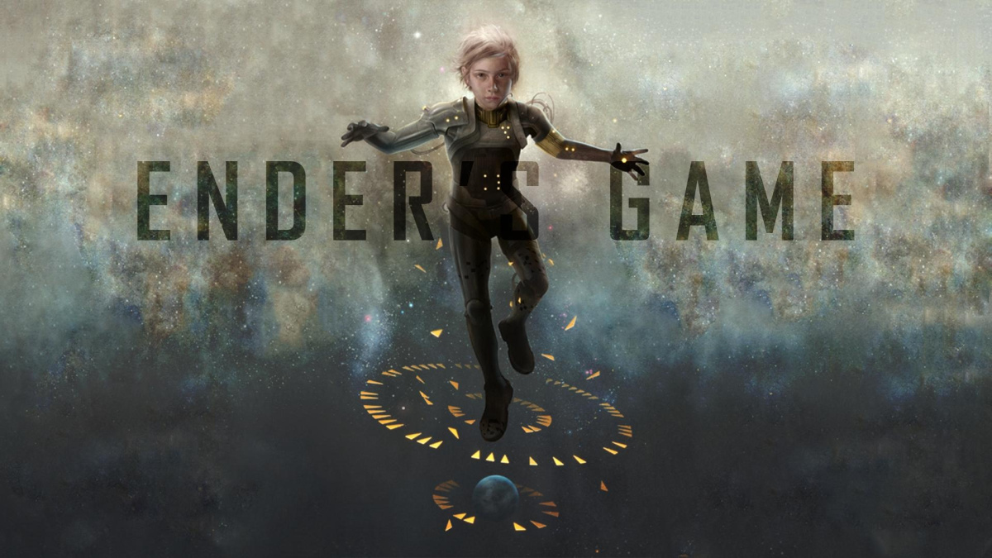
The ambiguity of a Child Hero
By Dylan Sain

Slide 2
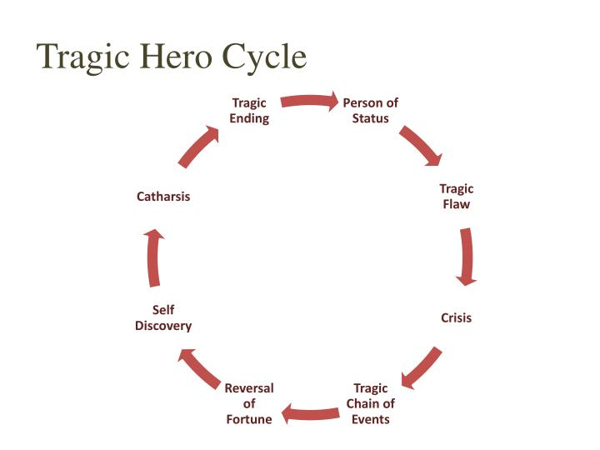
Ender as Tragic Hero

Slide 3
Person of Status / Tragic Flaw
Born an illegal Third child requested by government
6 years old when he got his monitor removed. (Harry Potter was 11, Katniss was 16)
Adults have power of the kids, and are able to manipulate and shape Ender into the perfect killer.
“It had to be a trick or you couldn’t have done it. It’s the bind we were in...somebody with that much compassion could never be the killer we needed. Could never go into battle willing to win at all costs. If you knew, you couldn’t do it (Card 298).”
-Colonel Graff to Ender after winning

Slide 4
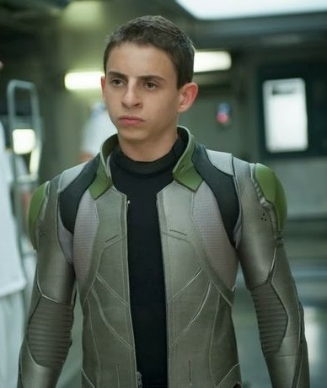
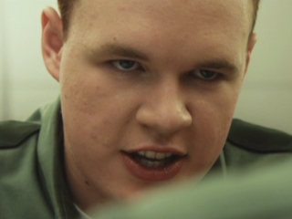
Crisis / Tragic Chain of Events
“Ender knew that at this moment he might be able to walk out of the room and end the battle...But the battle would only be fought again. Again and again until the will to fight was finished. The only way to end things completely was to hurt Bonzo enough that his fear was stronger than his hate....So Ender...kicked upward into Bonzo’s crotch, he connected, hard and sure (Card 211).”
“I have to win this now, and for all time, or I’ll fight it every day and it will get worse and worse. Ender knew the unspoken rules of manly warfare, even though he was only six. It was forbidden to strike the opponent who lay helpless on the ground; only an animal would do that. So Ender walked to Stilson’s supine body and kicked him again, viciously, in the ribs. Stilson groaned and rolled away from him. Ender walked around him and kicked him again, in the crotch (Card 7).”
Both times adults knew and did nothing to see how Ender would react
Ender became a killer

Slide 5
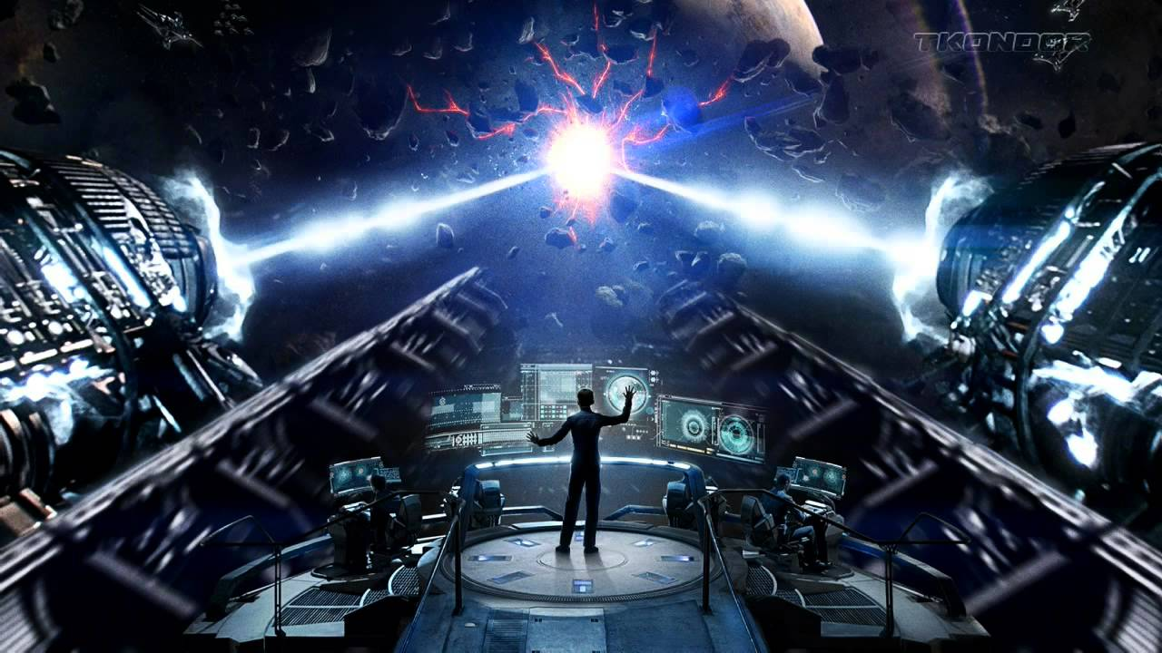
Reversal of Fortune
Destroys final planet
Figures out that the simulations were real
Hates himself for committing Xenocide
“I didn’t want to kill them all. I didn’t want to kill anybody! I’m not a killer! You didn’t want me, you bastards, you wanted Peter, but you made me do it, you tricked me into it! (Card 297-298).” -Ender to Mazer Rackham after beating the buggers

Slide 6
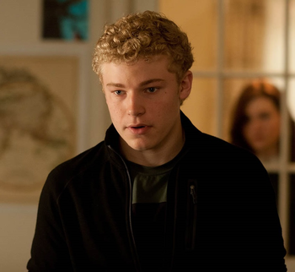

Self Discovery
Sleeps for 5 days
Has various dreams
Wants to become less like Peter and more like Valentine

Slide 7
Catharsis / Tragic Ending
Escapes by going to first colony ship
Finds Giants graveyard and fairy land
Finds egg in castle and learns about buggers
Writes the books The Hive-queen and The Hegemon
Destroys reputation as Ender to become the first Speaker of the Dead
“It was written as if the hive-queen spoke, telling all that they had meant to do, and all that they had done. Here are our failures, and here is our greatness; we did not mean to hurt you, and we forgive you for our death...When [Peter] died, Ender wrote a second volume, again signed by the Speaker for the Dead. Together, his two books were called the Hive-Queen and the Hegemon, and they were holy writ. (Card 321-323).” -Ender on his books The Hive-queen and The Hegemon

Slide 8
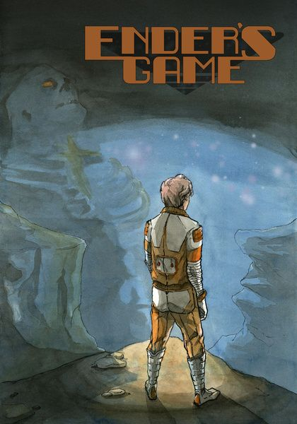
Ender as Monomyth

Slide 9
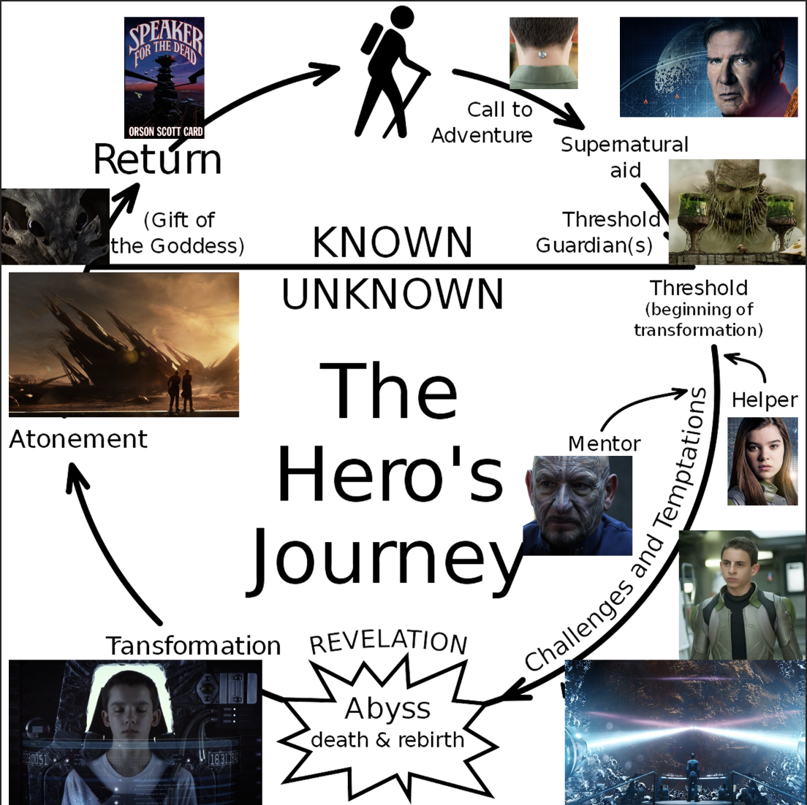
Additional Steps:
Miraculous Birth: Ender was born a illegal Third child under the government’s command
Refusal of the Call: Beating Stilson in because he needed to protect himself now
First Death/Resurrection: Going back down to Earth to reconnect with humanity and continue motivation
Reward(humans): Becoming admiral and receiving money
Return to Normal: Meets Valentine again

Slide 10
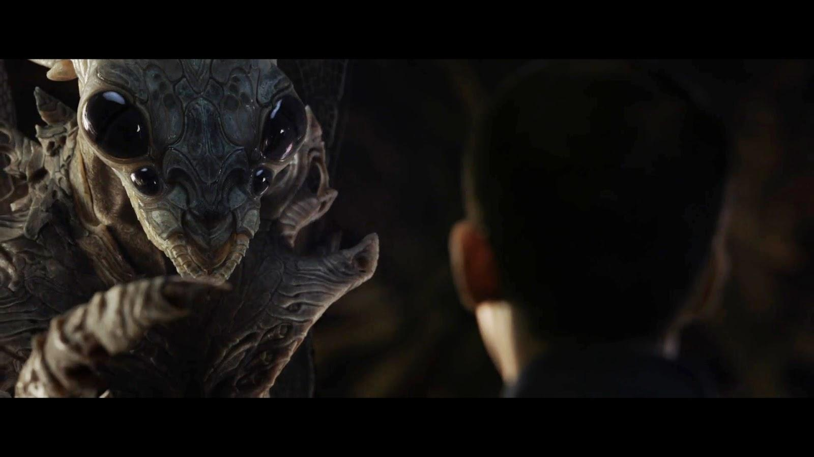
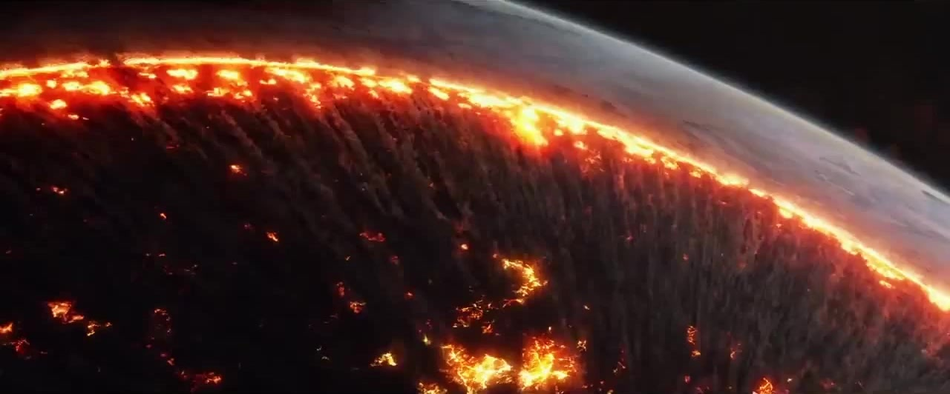
Duality of Hero and Villain
Ender becomes known as “The Xenocide”
Andrew Wiggin travels the stars as a Speaker for the Dead
Writing the book’s saves Andrew, yet destroys Ender
Creates the ambiguity of Ender being able to be both savior and destroyer for the buggers and humanity

